Slide 1
Join at menti.com and use
1847 3742

Slide 2
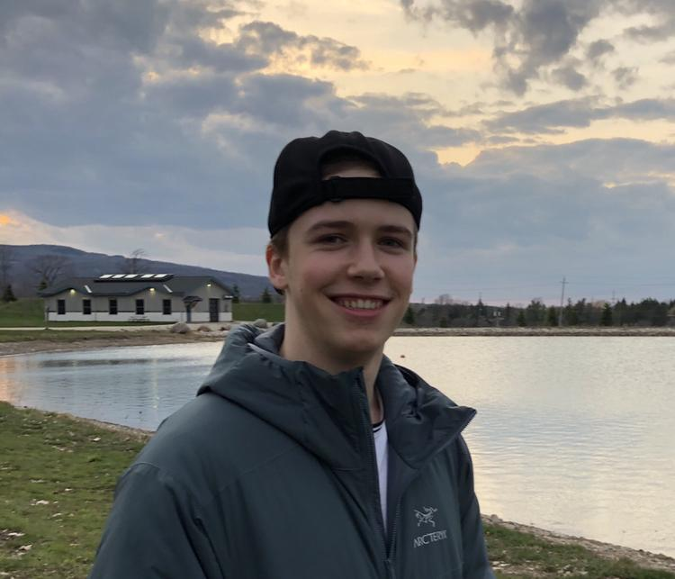
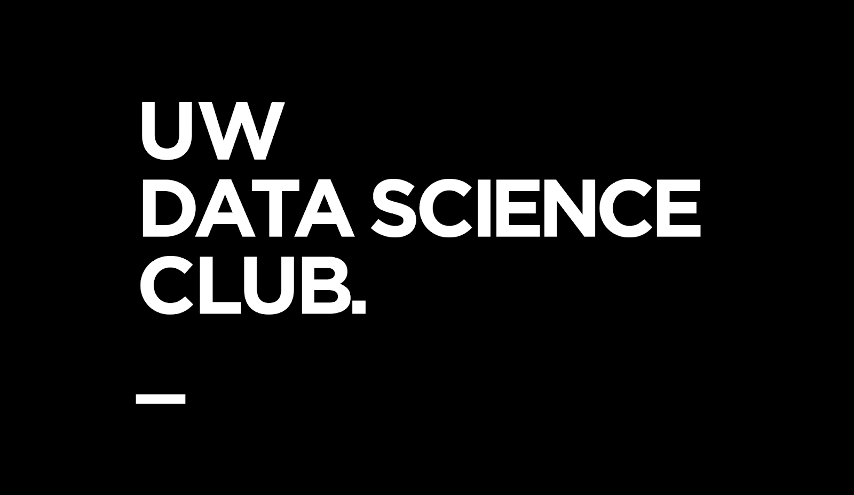
INTRO TO
DIFFUSION MODELS
Presented by Jack Douglas
Notes:
Hey everyone! Welcome to the Intro to Diffusion Models workshop. My name is Jack Douglas, and I am the VP of Education for the UWaterloo Data Science Club. Let’s get started.

Slide 3

Workshop Overview
Intended Audience: Intermediate to Advanced Data Scientists
Goals:
Learn about deep generative models, their applications, and overview of techniques
Learn the intuition/theory behind diffusion models
Learn how to create and use diffusion models on your own!
Notes:
Here is the a general overview about the intended audience and the goals for this workshop. This workshop is target towards intermediate to advanced data scientist. If you are new to data science, that is totally ok. We’re still going to be going over some background and there will still be a ton to takeaway from this workshop.
The first goal of this workshop are to learn about deep generative models, their applications, and a brief overview of the generative modelling landscape.
The second goal of the workshop is to gain an intuition and learn some of the theory behind diffusion models.
The last goal of the workshop is to learn how to apply this knowledge on to create a diffusion model on your own!
The last thing I will say before moving on is that I am going to be going over a lot of information in this workshop. For that reason, the slides and notebook are going to be made available to you all for future reference and I hope you can use them and look back on them to remind yourselves of what was discussed. You’re welcome to take notes if you like but I would personally recommend just trying to pay attention and absorb the info. You’ll gain a better intuition for the material that way and you can refer back to specific slides in the future.

Slide 4
Workshop Outline
Deep Generative Modelling
What is Deep Generative Modelling?
Generative Modelling for Computer Vision
Motivation
Theory
Background Information
Markov Chains
Forward Diffusion Process
Reverse Denoising Process
Putting It All Together
Conditioning Diffusion Models
Implementation and Applications in Notebook
Notes:
Here is the workshop outline.
For the deep generative modelling section of the workshop, I’m going to discuss what is deep generative modelling, look at the generative modelling landscape for computer vision, and finally the motivation for this field.
Next, for the theory section of the workshop, I’m going to start by going over background information on Markov chains, the forward diffusion process, and variational inference. Next, I’m going to talk about how these components are applied in the diffusion model architecture. And finally, I’m going to touch on how diffusion models can be conditioned such as text-to-image models.
And last, for the application section of this workshop, I’m going to look at two Google Colab notebooks: one which uses the Hugging Face Diffusers library and one which makes a diffusion model from scratch with PyTorch!

Slide 5
Deep Generative Modelling

Slide 6
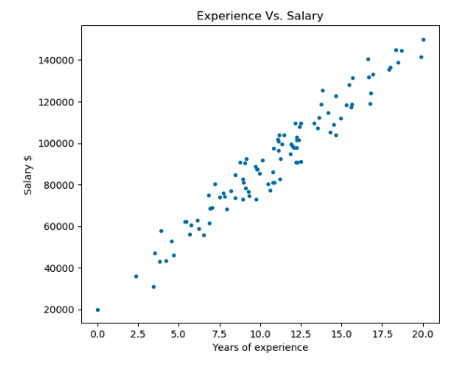
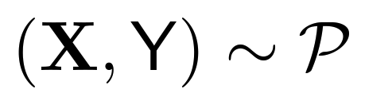
Probabilistic Machine Learning
some distribution P
Notes:
I want to start with an example to help explain and motivate the purpose of deep generative modelling.
Suppose we have a dataset visualized on the left which relates years of work experience to salary. And suppose that we are tasked with estimating someone’s salary given their years of work experience using this dataset as reference. Hopefully you’ve seen this type of problem before. If you haven’t, that’s ok. We have workshop on regression analysis on our YouTube channel which you will find very helpful.
When approaching problems like this one, we make assumptions about the data, namely that it follows some distribution that we will call P. It’s important to understand that we make this assumption because if the data doesn’t follow a distribution (whether it’s a well-known distribution or an incredibly complex distribution), we can’t create a probabilistic model that will extrapolate to new data. In this case, if this experience vs salary didn’t follow some distribution, we would be unable to come up with any probabilistic model that can effectively estimate someone’s salary given their experience.
So the main takeaway is that to come up with a probabilistic model, we must assume that data follows a distribution. If we again look at this dataset, we might think that linear regression is an appropriate model type for this data.

Slide 7
Probabilistic Machine Learning
some distribution P
Notes:
An assumption of linear regression is that the dataset follows a normal distribution.

Slide 8
Probabilistic Machine Learning
some distribution P
Notes:
This means that if we have 10 people who all have the same years of experience (let’s say 12.5 years), we want our model to estimate the salary which applies to the most number of people Notice with our model signified by the orange line, we would predict that someone with 12.5 years of work experience would have a salary of about $10,000.

Slide 9
Probabilistic Machine Learning
some distribution P
Notes:
And in the dataset, the majority of samples with about 12.5 years of experience also had about $100,000 salary. But notice that there were some samples with 12.5 years of experience which made more and some that made less. And this makes sense because in the real-world, not everyone with the same amount of experience has the same salary.

Slide 10
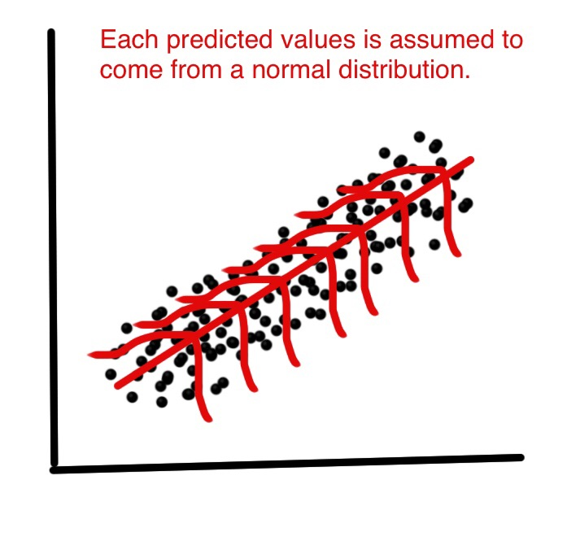
Probabilistic Machine Learning
Notes:
So when using linear regression, we are making predictions assuming the data comes from a normal distribution.

Slide 11
Probabilistic Machine Learning
some distribution P
Notes:
Now consider a different type of problem, suppose we wanted to create new data points for this experience vs. salary dataset. How would we do that?

Slide 12
Probabilistic Machine Learning
some distribution P
Notes:
Well, we could create points just along our line of best fit but this wouldn’t actually make our model necessarily better because these points aren’t reflective of the real-world in which there is a spread of values.

Slide 13
Probabilistic Machine Learning
some distribution P
Notes:
A better solution could be to create points which follow the normal distribution! In other words, add many points around where we are currently fitting the data, but also add fewer and fewer points the farther we get from this line of best fit. So, understanding the distribution of dataset is helpful in generating new data points.

Slide 14
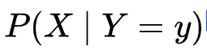
What is Deep Generative Modelling?
Def’n: collection of deep learning techniques that are used to learn the underlying distributions of a dataset so as to generate new data points with some variations
Applications
Image generation
Audio generation
Code generation
Given a target y, probability of the observable X
Notes:
This brings us to what is deep generative modelling. I’ve provided this definition on this slide, and I’ll be continuing to include definitions of terminology on the slides throughout this workshop. Deep generative modelling refers to a collection of deep learning techniques that are used to learn the underlying distributions of a dataset so as to generate new data points with some variations
The goal is to understand the underlying distribution of the dataset (commonly referred to as the posterior distribution), and sample new data points using this estimated distribution.
Applications of deep generative modelling apply to image generation, audio generation, and even code generation which we talked about in our last reading group session (which by the way we are having the next session this coming Sunday).
Today we’re really going to just be focusing on image generation because that is the main application of diffusion models but many of the concepts we’ll be discussing today are applicable to all forms of generative modelling.

Slide 15
Generative Modeling for Computer Vision
Variational Autoencoder (VAE)
Encoder-decoder architecture
Interpolates between low dimension latent space to produce new images
2013
Notes:
Now I just wanted to briefly give some background on the landscape of generative modelling specifically for computer vision.
The variational autoencoder (or VAE) is a neural networks architecture invented in 2013. It is an encoder-decoder architecture, which is a very common and useful architecture which we discussed previously in our Transformers workshop. And from a higher level, a VAE works by first encoding images of a dataset into a low dimension latent space. Next, the model interpolates between these latent space representations. And the final step of the image generation is to sample along this interpolation in the latent space and pass the sample through the decoder to generate new images. So in a way, it can be thought of as finding attempting to find the similarities between images in a dataset to generate new images.

Slide 16
Generative Modeling for Computer Vision
Variational Autoencoder (VAE)
Encoder-decoder architecture
Interpolates between low dimension latent space to produce new images
Generative Adversarial Network (GAN)
Two competing networks: generator and discriminator
Objective is for generator to fool the discriminator
2013
2014
Notes:
Next, GANs were developed by Ian Goodfellow in June 2014. As an aside Ian Goodfellow co-wrote the textbook Deep Learning which I would highly recommend checking out if you haven’t already. A GAN is composed of two competing networks: a generator and a discriminator. The generator as the name implies generates new images and a discriminator is then shown images tries to discern if they are “real” and “generated” images. The generator learns to fool the discriminator network and in doing so generates high-quality images.

Slide 17
Generative Modeling for Computer Vision
Variational Autoencoder (VAE)
Encoder-decoder architecture
Interpolates between low dimension latent space to produce new images
Generative Adversarial Network (GAN)
Two competing networks: generator and discriminator
Objective is for generator to fool the discriminator
Denoising Diffusion Probabilistic Model (DDPM)
Markov chains trained using variational inference
Forward diffusion process + reverse denoising process
2013
2014
2020
Notes:
Last, are the denoising diffusion probabilistic models which are the focus of this workshop. They are abbreviated as DDPMs or just diffusion models, which is what I will be doing for the remainder of this workshop. A very quick summarization of what diffusion models are is that they are markov chains trained using variational inference. And they rely on two processes: a forward diffusion process and a reverse denoising process. I will go into more detail on what this means in the duration of the workshop.
There are several more generative modelling techniques for computer vision than these 3 including flow-based models and energy-based models, but these 3 techniques are the most well-known in the space.
We’re going to be focusing on diffusion models today, but I’d highly recommend spending time learning about variational autoencoders and GANs too!

Slide 18
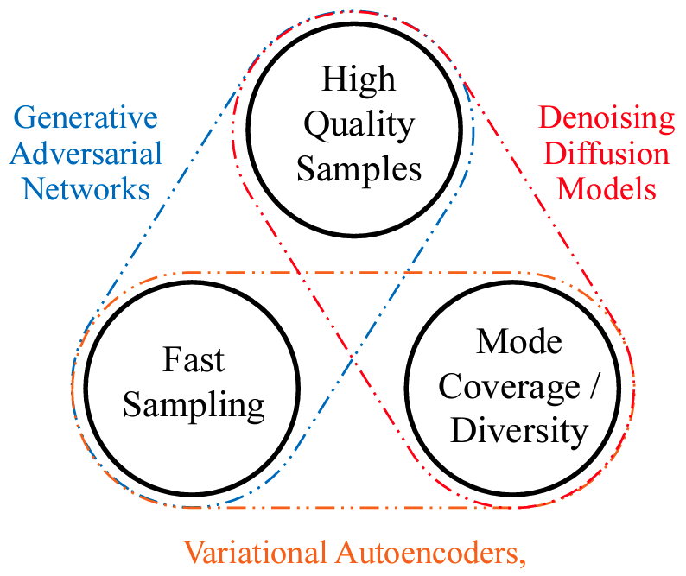
Evaluating Generative Models
Deep generative models are commonly evaluated using 3 criteria:
Speed
Quality
Diversity
Notes:
Generative models, especially with respect to image generation, are commonly evaluated using three criteria: the speed, quality, and diversity of image generation. And the image on the left shows that each of three generative techniques I discussed before have some strengths and weaknesses. This isn’t super conclusive though and diffusion models have become faster at sampling and GANs diversity of image generation has also improved but it’s just important to be aware that these techniques have limitations.

Slide 19
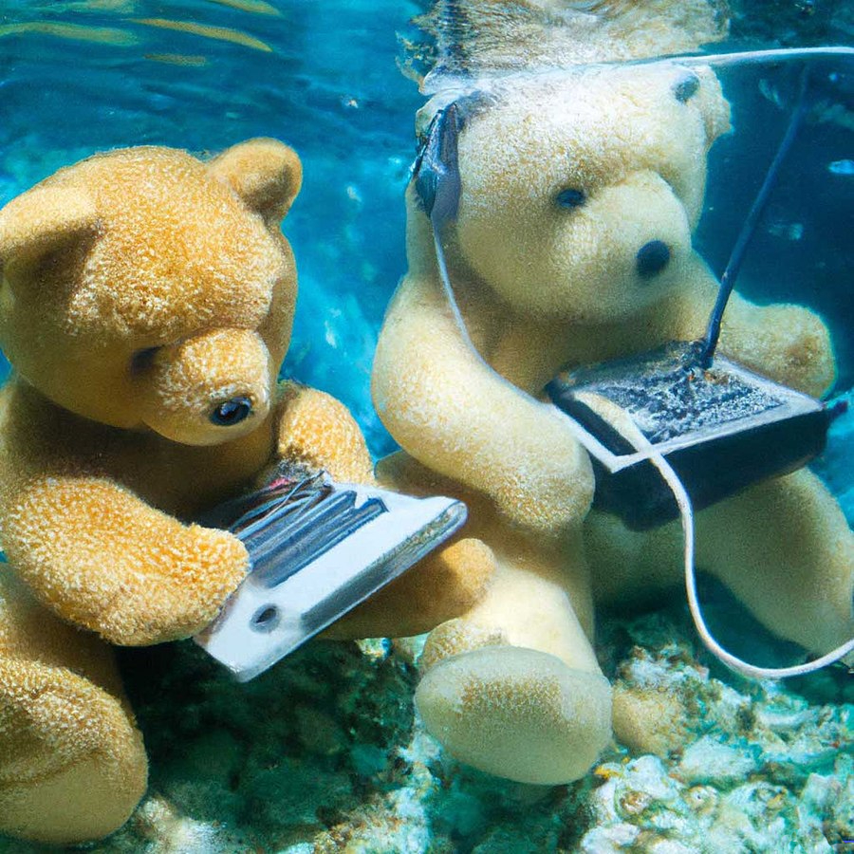
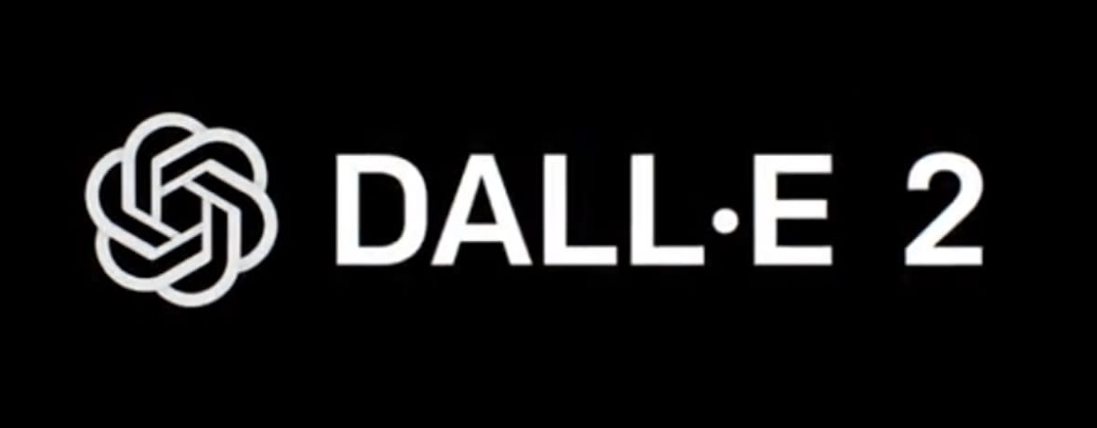
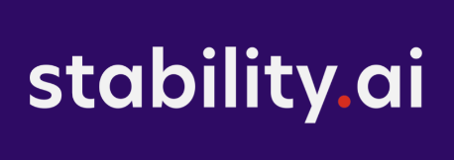
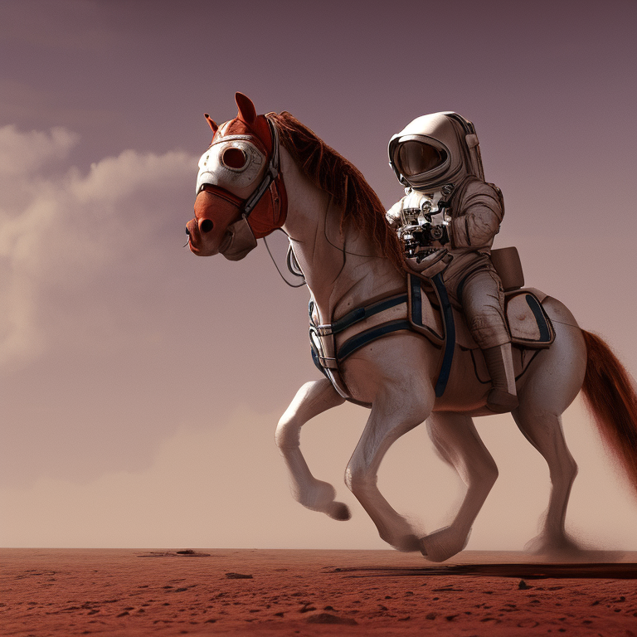

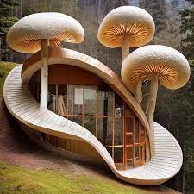
Motivation
Popular diffusion models include DALL-E 2, Stable Diffusion, Midjourney, Imagen, etc.
Generative AI companies have raised $2.2 billion in 2022
Huge opportunities in image generation particularly for healthcare and self-driving
Notes:
To further motivate learning about diffusion models and attending workshop, I just wanted to bring up some examples of companies that are using diffusion models including DALL-E 2, Stable Diffusion, Midjourney, Imagen, and more.
And this is a growing space; in 2022, generative AI companies raised $2.2 billion. Stability.ai and Midjourney haven’t raised money yet but is definitely a likely possibility in the near future.
And there are huge opportunities in image generation particularly for healthcare (for example generating ultrasound or MRI images of diseases to improve diagnosis) and self-driving.

Slide 20
Questions?
Notes:
So that concludes what I wanted to talk about deep gener

Slide 21
Theory
Notes:
Now into the theory section of diffusion models.

Slide 22
What is a Diffusion Model?
Def’n: a parameterized Markov chain trained using variational inference to produce samples matching the data after finite time.
Transitions of this chain are learned to reverse a diffusion process, which is a Markov chain that gradually adds noise to the data in the opposite direction of sampling until signal is destroyed.
Notes:
So here is a long definition describing what a diffusion model is. A diffusion model is a a parameterized Markov chain trained using variational inference to produce samples matching the data after finite time. Transitions of this chain are learned to reverse a diffusion process, which is a Markov chain that gradually adds noise to the data in the opposite direction of sampling until signal is destroyed.
This definition might not make complete sense at first and that’s ok. We’re going to go over specifically the highlighted parts of this definition. First, going to look at Markov chains, then look at the diffusion process, then look at variational inference, and finally see how these fit together to make a diffusion model.

Slide 23
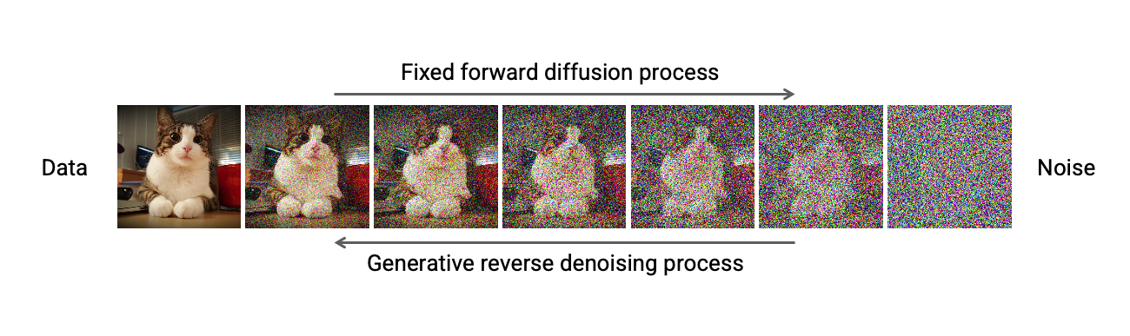
What is a Diffusion Model?
Notes:
Here is a visualization of what is happening in a diffusion model. We start with original data on the left, and we apply the forward diffusion process to get just noise on the right. And then we train a model to learn to apply the reverse denoising process to generate new images. So we’ll break down each of these parts and how they work.

Slide 24
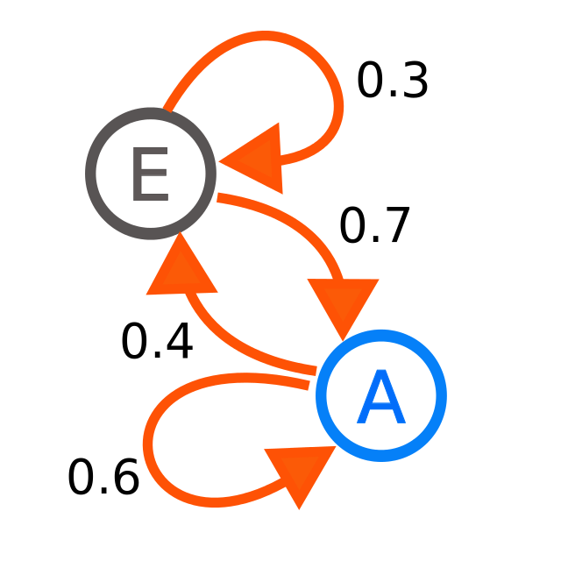
What is a Markov Chain?
Def’n: a mathematical model which describes a sequence of possible states/events and the probability of transitioning between them
Applications
Google PageRank
Physics
Health
Forecasting
Notes:
So, we’ll start by asking what is a markov chain? It’s defined as a mathematical model which describes a sequence of possible states/events and the probability of transitioning between them. So on the right, we have two states or events labelled E and A. And the arrows signify the probability of transitioning from one state to the next. An important point about Markov chains is that the probability of going to a state depends only on the state attained in the previous event and the associated transition between the two. Informally, this may be thought of as, "What happens next depends only on the state of affairs now."
Ultimately, a markov chain is a simple statistical model which represents stochastic or non-deterministic processes.
Google PageRank
Health (infectious diseases, genetics, etc.)
Forecasting (finance, weather, etc.)

Slide 25
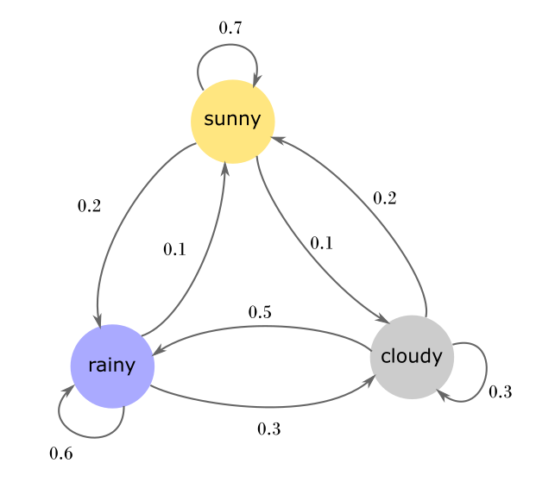



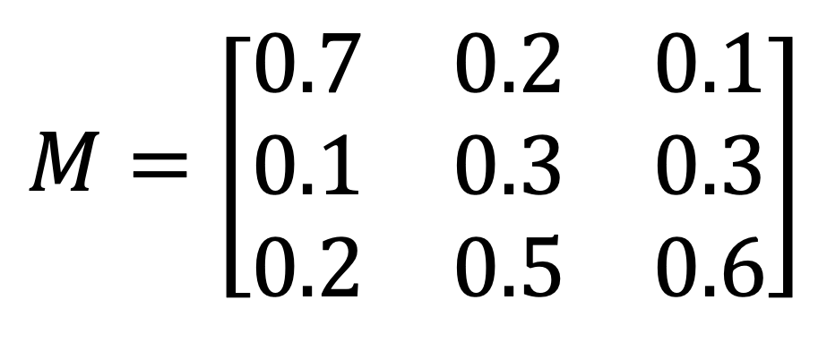
Markov Chains
from
to
Notes:
Here is an example of a markov chain where we have 3 states representing the weather: either sunny, rainy, or cloudy. Again, he arrows signify transitions between the states and they have transitions’ associated probability. On the right, we have a Markov transition matrix which shows the probability of transitioning from one state to another.

Slide 26
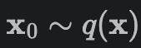
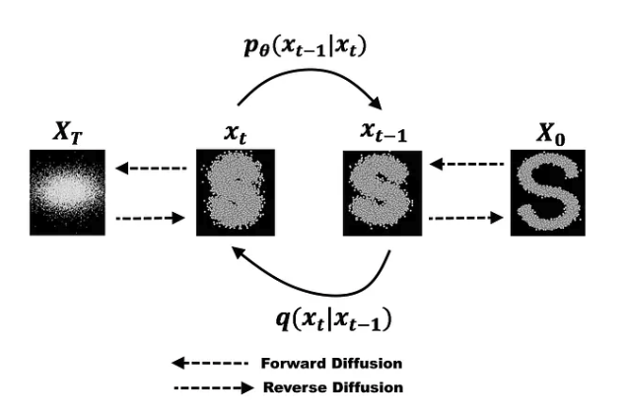
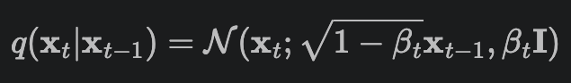
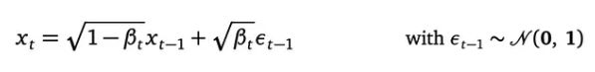
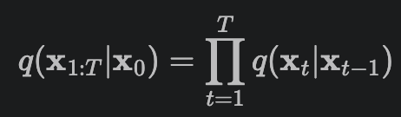
Forward Diffusion Process
Def’n: a continuous-time Markov process in which a small amount of Gaussian noise is added to an original image x_0 for T time steps
B_t is the noise scheduler
Notes:
So now we’ll look at what is the forward diffusion process. It is a continuous-time Markov process in which a small amount of Gaussian noise is added to an original image x_0 for T time steps.
So here in the diagram on the bottom left, we have the forward diffusion process, where we have the initial state on the right which is an original image in a dataset and the transitions between states are from right to left. So we can see that it is a markov chain in which each transition, given the previous state, adds noise to get to the next state.
I’ve also included some of the math involved in the forward diffusion process for those that are interested. I’ll give some brief intuition for what it means and how it is relevant, and we’ll move from the top equation to the bottom equation. So at the top, we have x_0 is the original image follows a real-data distribution q and it is the probability density function which describes the forward diffusion process and how noise is added to the image. In the second equation, we q(x_t, x_(t-1)) which describes a single step in the forward diffusion process. B_t is the noise scheduler also known as the variance scheduler and if you’re familiar with neural networks, it is similar to how the learning rate is scheduled. And it is usually on the scale of 10^-3 or 10^-4 because we want each step to be introducing only a very small amount of noise, but we set the number of time steps to on the order of 1,000 so we have many of these small noise steps which yields complete Gaussian noise. The third equation actually shows how the image is updated and epsilon is sampled from a standard Gaussian noise distribution and it is the same dimension as the image. The final bottom equation defines the entire forward diffusion process and we see that since this is a Markov chain, each transition is only dependent on the previous state so we can multiply our probability density function for each step to define the entire forward process.

Slide 27
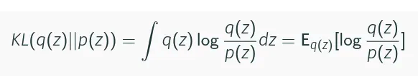
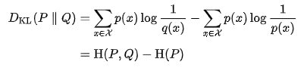
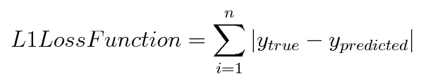
Variational Inference
Def’n: a method of approximating a complex distribution with some family of parameterized distributions
where H is the cross-entropy loss function
Notes:
So you might be familiar with latent variables, which are variables which are indirectly inferred from a model which uses an observable variable. Similarly, variational inference is a method for approximating a complex distribution using a distribution which is “close” to the one we are looking for. So recall from the beginning of this workshop that our ultimate goal is for us to try and find the posterior distribution, or the underlying distribution of the data. We measure if two distributions are “close” using what’s called the KL-divergence formula shown in the top image. I won’t get into too much detail about it’s derivation but just understand the original theory for diffusion models was derived using the KL-divergence loss.
In practice, several other loss functions can be used in KL-divergence’s place and act as a surrogate loss function. In the middle image, we can actually see that that the KL-divergence loss function can be written in terms of the cross-entropy loss function. And since the cross-entropy of the same distribution is a constant, they have the same optimization results. Similarly, other loss functions can be used in their place and in the notebook later, I will be using the L1 loss function for convenience. The L1 loss function stands for least absolute deviations and has a very simple formula shown on the bottom.

Slide 28
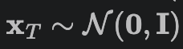
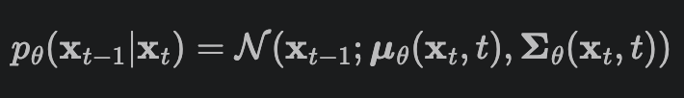
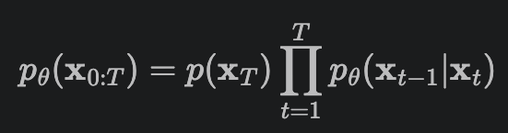
Reverse Denoising Process
Def’n: the iterative process for “denoising” complete Gaussian noise that is learned by a neural network via variational inference.
Notes:
So the reverse denoising process is where the variational inference occurs. It is an iterative process for denoising complete Gaussian noise and it is done using a neural network.
It is the sampling procedure for generating new images
Takes in a noisy image x_T and outputs a less noisy image x_(T-1)
Usually a U-Net
Again, I’m including some math which I will explain briefly from top to bottom. The top equation is the our input to the neural network which we’ve sampled from standard Gaussian noise. And we are trying to have the neural network learn the reverse denoising process defined by p_theta(x_(t-1) given x_t). And finally, the bottom equation, similar to the forward process, we can define the entire reverse process by multiplying the PDF for each state since it is a modelling a Markov chain.

Slide 29
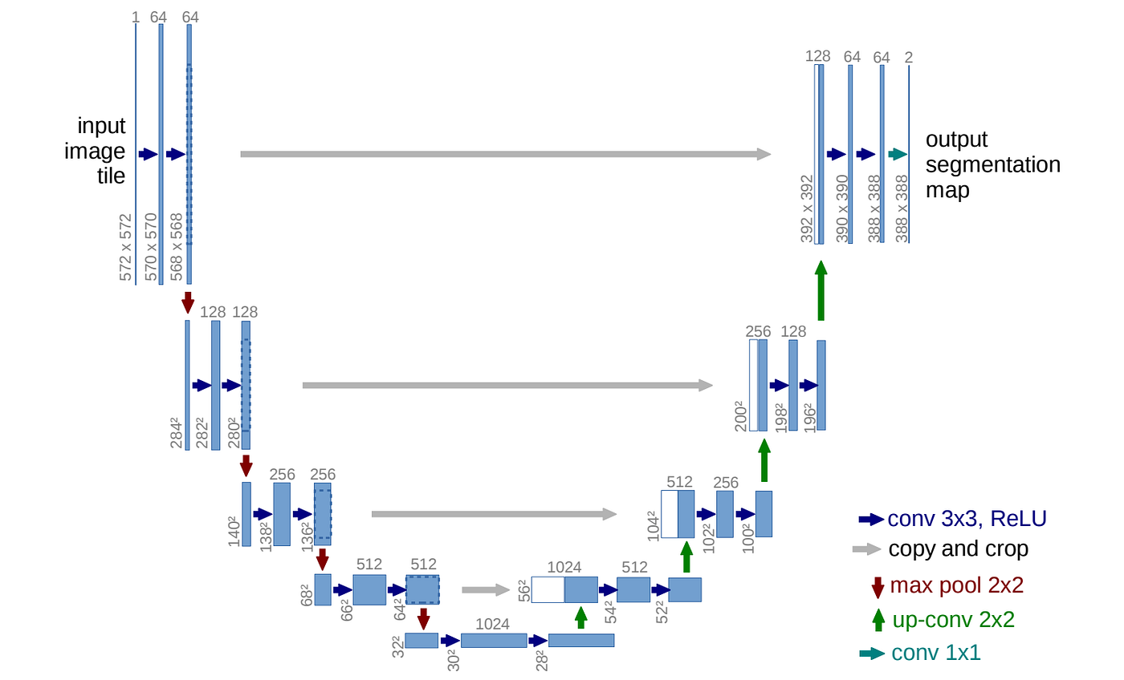
U-Net
Notes:
This is visually the design of a U-Net, which is what inspired its name. The first half of the U-Net shrinks the input image and extracts meaningful information using a combination of convolutional and pooling layers. The second half of the U-Net reverses this process and expands the feature maps until the output is the same size as the input. As well, there are skip connections indicated by the grey arrows which connect the first and second halves of the model, which helps to fill in gaps in the up-sampling process and is helpful when calculating gradients in the training process. The U-Net was originally design for semantic image segmentation in the medical field back in 2015, but it was so versatile it had success being applied to other domains, one of them being diffusion models

Slide 30
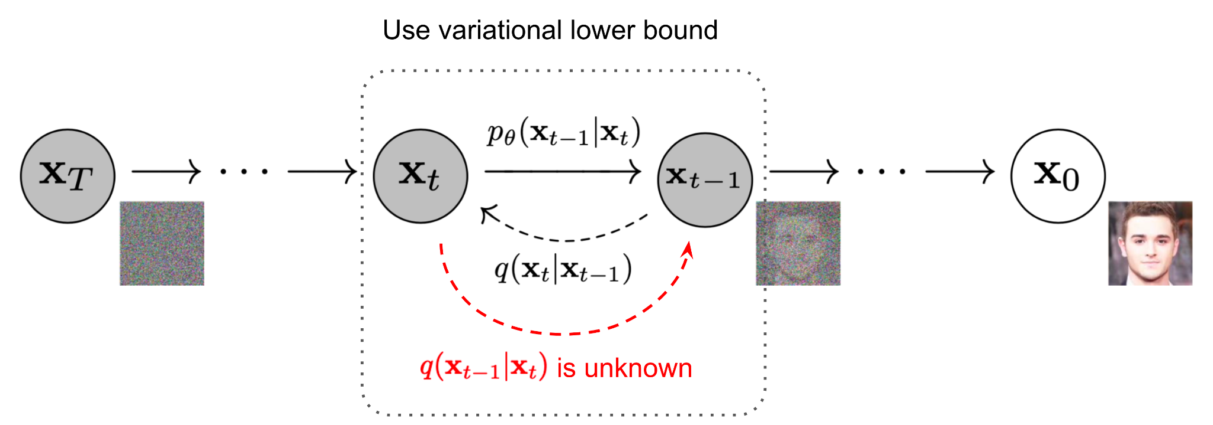
Putting It All Together
Notes:
So putting it all together, we have the forward diffusion process which takes an original image from the dataset, and iteratively adds noise until we get complete Gaussian noise. Then, to generate or sample new images, we start with complete Gaussian noise on the left, and iteratively denoise our image. Both processes are Markov chains. We use variational inference to derive an objective function which relates how closely we can approximate the reverse denoising process and use this loss function for training the U-Net.

Slide 31
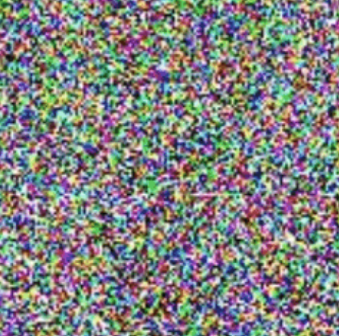
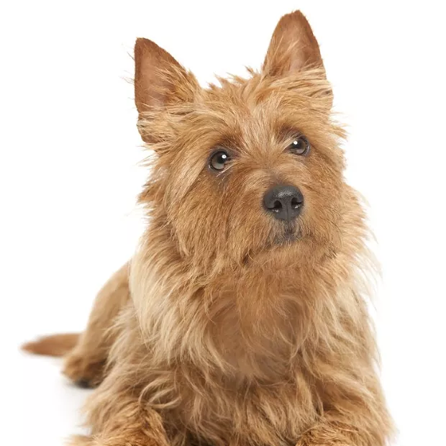
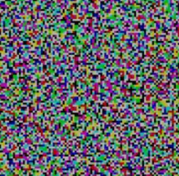
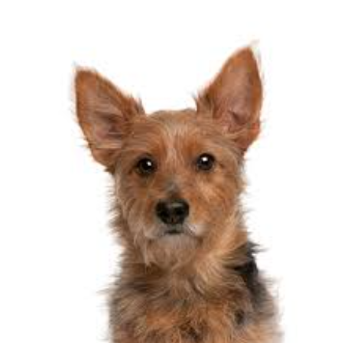
Putting It All Together
Training
Inference
Step 1: Forward Diffusion (No Learning)
Noise sampled from Normal Distribution
Over T timesteps
U-Net
Step 2: Iterative Denoising Process
Over T timesteps
Over T timesteps
U-Net
Notes:
So here is another slide illustrating the entire process for training the diffusion model and making inferences.
The training section has two steps: first the forward diffusion process (but no learning occurs here). Second, we pass images through a UNet which iteratively denoises the image. And the UNet learns to predict the noise in an image given a noisy image so that it can then be removed. The reverse process is done over T timesteps, where the model is fed back into the U-net (similar to an RNN), each time getting clearer and clearer. We’re not expecting the output of the U-Net to be exactly the same as the input, just of the same distribution (hence the different dog images)
To generate new images, we sample from the normal noise distribution, and pass it through our U-Net which iteratively denoises the image until we ultimately have a new image. This iteratively occurs also over T timesteps.

Slide 32
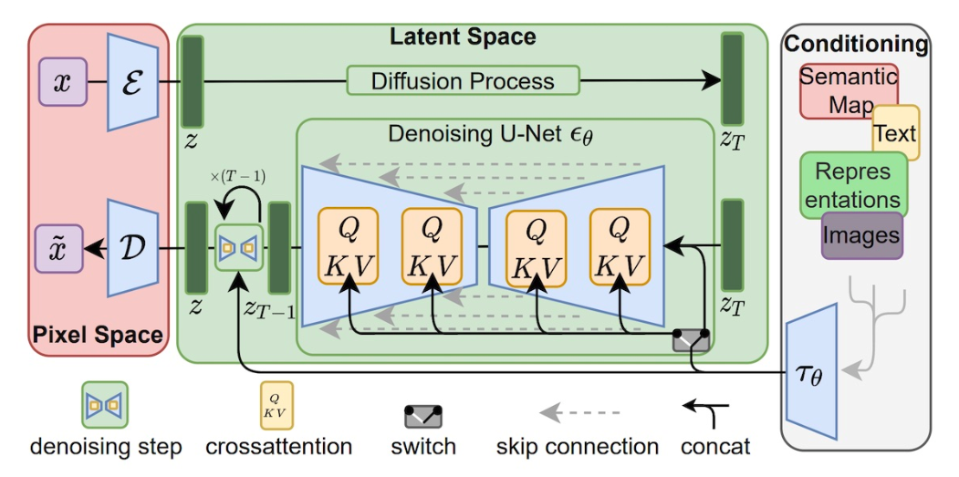
Conditioning Diffusion Models
Notes:
So far I have been just talking about purely image generation using diffusion models, meaning you train a diffusion model on a specific dataset and it will generate new images for that dataset. For example, it may be a dataset of dogs, and you train a diffusion model on that dataset to produce new images of dogs.
But you might curious how Stable Diffusion or Midjourney which are diffusion-based models are able to use text to generate images and have enormous variance in what you can prompt. These are called text-conditioned diffusion models, or text-to-image models. I won’t go into the technical math details on this section but will just give an overview of the condition diffusion models landscape.
You can condition models with text, other images, outlines, and more as represented on the right. You might notice that there are cross-attention layers in the U-Net, these are included to handle the text input. As well on the left, you can see that a decoder and encoder were used to augment the diffusion model. This is because
If you aren’t familiar with encoders, decoders, or cross-attention, we discussed these concepts in the Transformers workshop we had before so I recommend checking out that recording on our YouTube channel if you are unfamiliar.

Slide 33
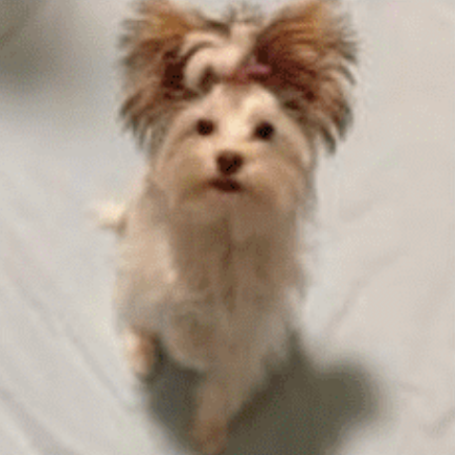
Text-Conditioned Diffusion Models
Step 1: Forward Pass
The text prompt is used to guide the model during the denoising step
Models like Stable Diffusion improve on this using other techniques:
Classifier-Free Guidance
Latent Space Representation
Read More: https://eugeneyan.com/writing/text-to-image/
Step 2: Denoising Process
“A Brown Terrier”
Text Encoder
Notes:
So I’ll focus on text-conditioned diffusion models for a second.
The forward pass remains the same as before.
However, during the denoising reverse process, the original image’s caption is encoded and embedded into the diffusion model. The diffusion model learns to associate that caption with the generated image.
Through this method, the conditioning doesn’t necessarily need to come from text, but can come from any other conditioning (e.g. speech, another image, etc.) as long as it gets properly encoded and embedded.
This covers the general idea of text-conditioned diffusion models, but models like stable diffusion use other tricks which significantly improves performance:
First, Latent space representation:
Idea: Perform additional processing in a latent space. Step 1: Compress image to lower dimensions using an encoder. Step 2: Perform same forward and reverse diffusion procedure described earlier in lower dimension. Step 3: Decode denoised variables back into an image using a decoder.
Why? Reduced dimensions removes any unneeded information and allows diffusion model to focus only on the pixels with meaning. Also allows for quicker and more efficient compute.
Classifier free guidance:
Idea: Produce the output of the diffusion model with and without the text embedding. Calculate the difference between them and amplify that signal. This boosts the amount of information specifically added through the text encoder..
Why? It makes the output more tied to and dependent on the information from the input text

Slide 34
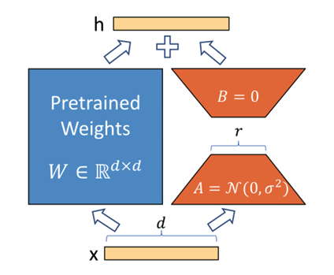
Low-Rank Adaption (LoRA)
Parameter-efficient fine-tuning technique (PEFT)
Training models can be costly and take considerable time
Pretrained weights (the blue part) are frozen; only train A and B (the red parts)
LoRA for Hugging Face Diffusers: https://huggingface.co/blog/lora
Single Attention Layer
Notes:
Last, we’ll look at the Low-Rank Adaptation technique also known as LoRA. It is frequently used to fine tune stable diffusion models and is generally known as a parameter-efficient fine-tuning technique
One of the issues with diffusion models is that the training and sampling process can take a long time and be expensive because of the iterative nature and having a high number of timesteps So instead of training from scratch, LoRA freezes the pretrained weights of a model and introduces rank-decomposition matrices which can be fine-tuned for a specific task. They have a fewer number of parameters so they can be trained quickly and since we are freezing the pretrained weights, we don’t have to worry about the model forgetting. And they are added in the attention layers of the U-Net. We will be using LoRA in one of our notebooks in just a second.

Slide 35
Questions?

Slide 36
Mentimeter Quiz!
Join at menti.com and use
1847 3742
Notes:
Now, let’s do a Mentimeter Quiz!

Slide 37
Diffusion Model Notebook
Diffusion Models from Scratch Notebook: bit.ly/3K8cqmz
Hugging Face Diffusers Notebook: bit.ly/3lkvpRD
Notes:
Here are two notebooks that I’ve adapted that we will quickly walk-through.

Slide 38
Resources
Math-heavy explanation: https://lilianweng.github.io/posts/2021-07-11-diffusion-models/
Hugging Face Diffusion Models Course: https://github.com/huggingface/diffusion-models-class/tree/main
Seminal DDPM Paper: https://arxiv.org/pdf/2006.11239.pdf
Creating a Text-to-Image Dataset: https://colab.research.google.com/github/huggingface/notebooks/blob/main/diffusers/sd_textual_inversion_training.ipynb#scrollTo=gIFaJum5nqeo&uniqifier=1
Notes:
Finally, here are some resources that I used and that I would recommend you check out if you want to learn more about diffusion models.
Thanks for attending this workshop!

